Slide 1
Comparing adaptive cognitive training in virtual reality and paper-and-pencil in a sample of stroke patients
International Conference on Virtual Rehabilitation 2019

Slide 2
Introduction
1. Still today, paper-and-pencil tasks are the most commonly used methods to train cognitive functions in clinical settings .
2. Rehabilitation with these tasks has shown to have a limited transfer to performance in activities of daily living (ADL) .
3. VR-based methods have shown potential to be ideal environments to incorporate cognitive tasks within the simulation of ADL’s.
4. How to bridge widely accepted paper-and-pencil methodologies with VR-based ADL’s simulations.
5. No study has explored associations between adaptation in traditional paper-and-pencil and VR training.

Slide 3
Introduction
6. We developed two content equivalent tools and clinically validated them with stroke patients: a web-based paper-and-pencil Task Generator and a VR-based simulation of different ADL’s, the Reh@City.
7. Three main questions:
(1) Are paper-and-pencil and VR training performances equivalent?
(2) Is performance modulated by the difficulty adaptation or the training methodology?
(3) Which training method is more intensive?

Slide 4
Methods
1. Participants:
(1) Task Generator (N=17)
(2) Reh@City (N=14)
2. Inclusion criteria:
(1) No more than 75 years old
(2) First ischemic stroke（缺血性卒中） episode and at least at 6 months post-stroke
(3) No hemi-spatial neglect （单侧空间忽略）
(4) Capacity to be seated and ability to read and write

Slide 5
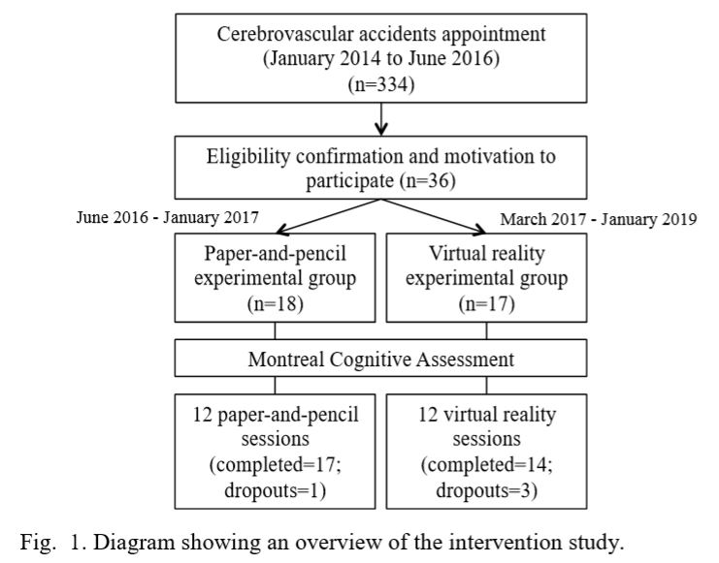

Slide 6
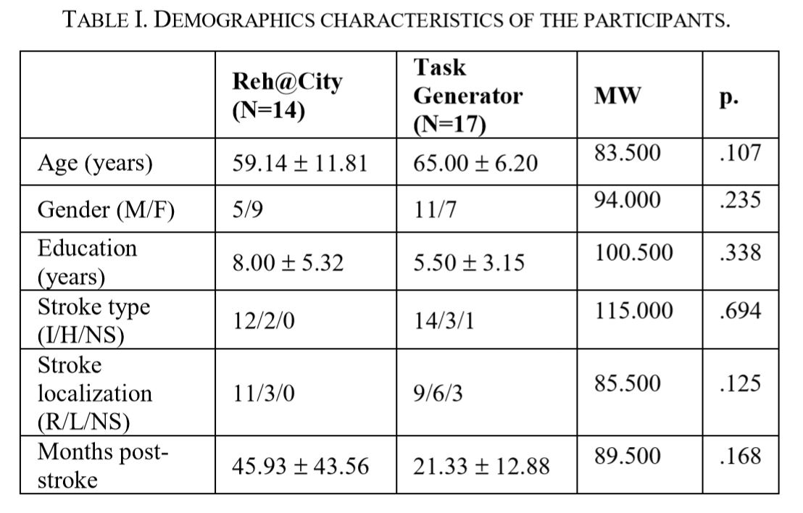

Slide 7
Methods
3. Protocol :
(1) All participants were assessed through the Montreal Cognitive Assessment (MoCA) before and after the intervention.
(2) Each participant went through a set of 12 30-minute sessions with a frequency of 3 per week.
(3) There was no predefined number of tasks that the participant had to complete.
(4) Difficulty level for the following set of tasks was calculated based on the participant’s performance.
(a)+0.5,if higher than 70%
(b)-0.5,if lower than 50%

Slide 8
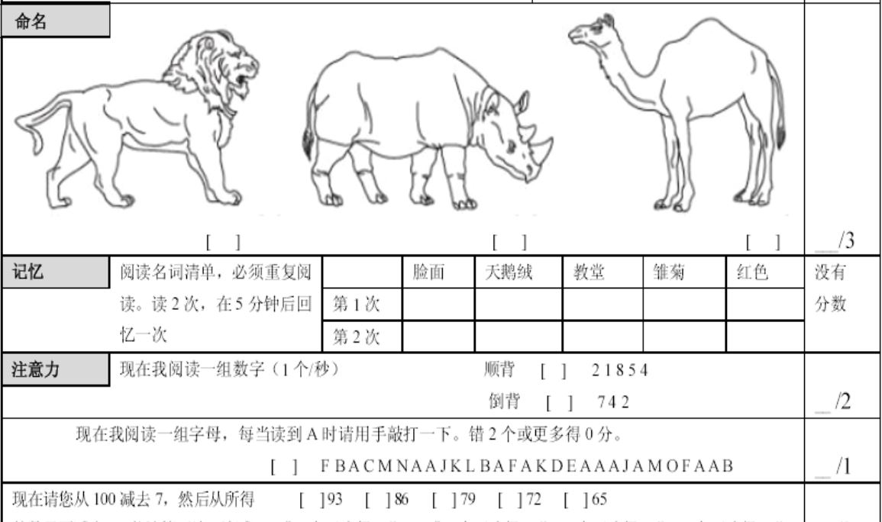

Slide 9
Methods
4. Groups:
(1) Task Generator
(a) Automatic generation of paper-and-pencil cognitive tasks tailored for each user profile.
(b) 11 cognitive tasks: cancellation, numeric sequences, problem resolution, association, comprehension of contexts, image pairs, word search, mazes, categorization, action sequencing, and memory of stories.
(b) Personalization of tasks depends on the user levels of attention, memory, executive function, and language found through the MoCA.

Slide 10
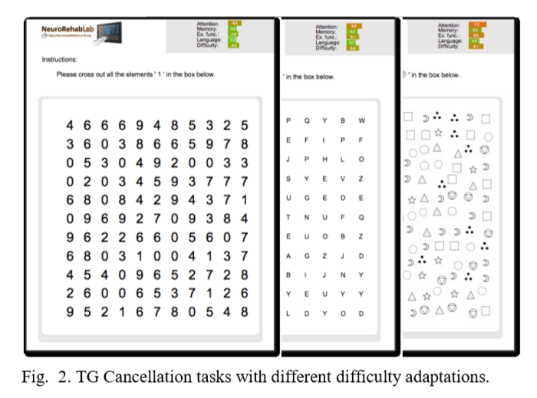

Slide 11
Methods
4. Groups:
(2) Reh@City
(a) The RC system is a virtual environment that consists of a city with different locations where the user can perform cognitive tasks equivalent to the ones generated by the TG.
(b) Each task starts by navigating to a specific location and then executing the task on that location.
(c) Tasks are personalized for each user profile based on the MoCA’s results of the same cognitive domains.
(d) Contrary to the TG, the RC allows evolving to difficulty levels above the maximum value of the scale, which is 10.

Slide 12
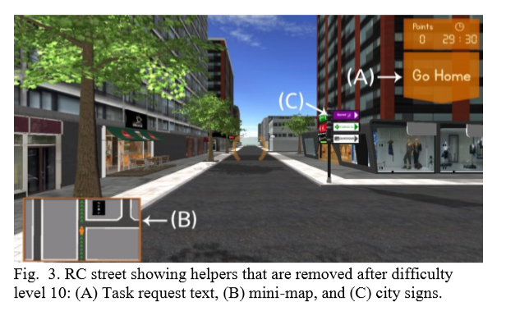

Slide 13
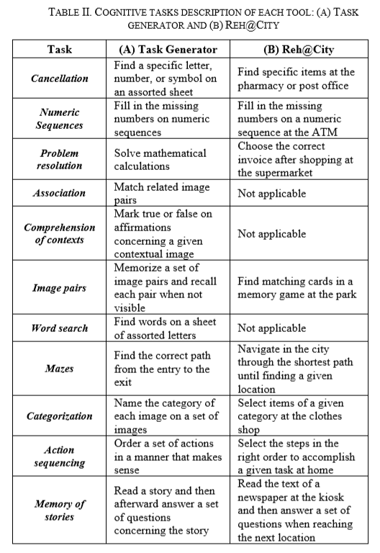

Slide 14
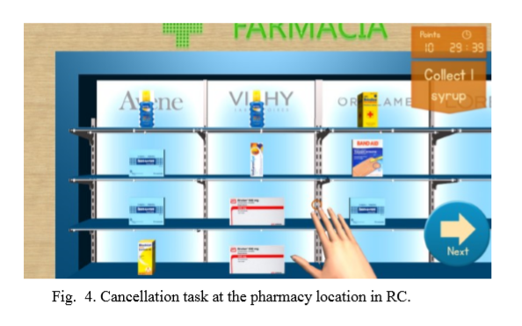

Slide 15
Results
1. Are paper-and-pencil and VR training performances equivalent?
(1) Regarding the twelve training sessions overall performance, no significant statistical differences were found.

Slide 16
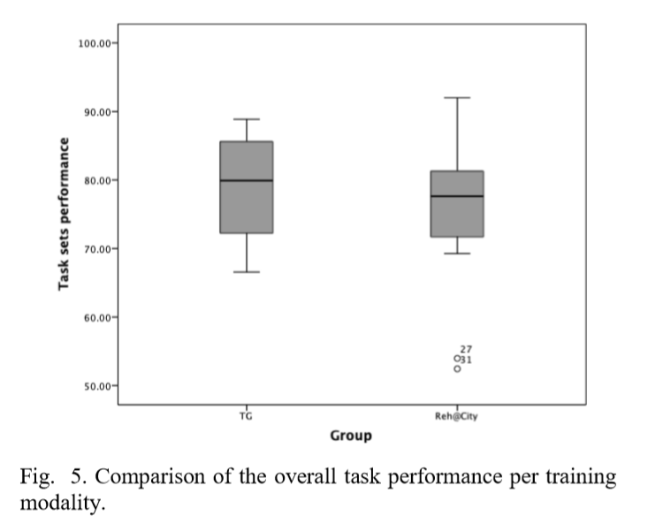

Slide 17
Results
2. Is performance modulated by the difficulty adaptation or the training methodology?
(1) According to the obtained results the main effect of the adapted difficulty was significant but not the training methodology.
(2) There is no clear specific preference for any approach, which is consistent with the lack of significant differences between overall performances in both training methodologies.

Slide 18
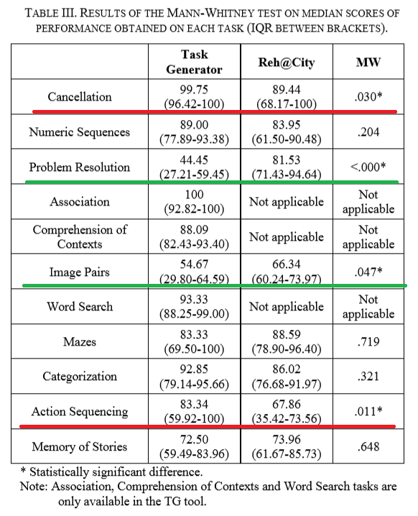

Slide 19
Results
3. Which training modality is more intensive?
(1) Both groups evolved in difficulty level in similar ways. However, the RC group evolved slightly faster and attained higher levels.

Slide 20
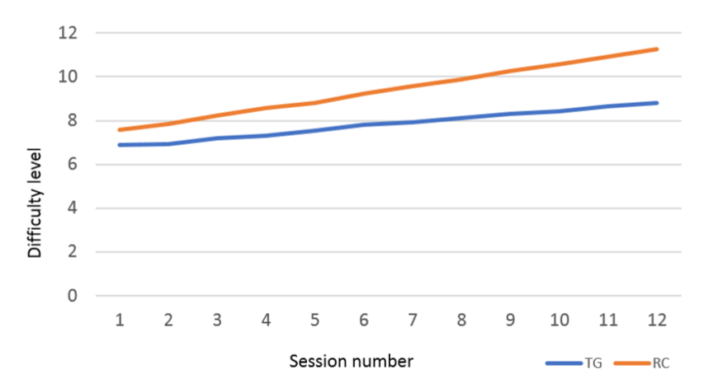

Slide 21
Conclusion
1. Our results contribute with new evidence and provide a further understanding of the impact of using adaptation in VR simulations of ADL’s in the rehabilitation of cognitive deficits.
2. RC offered a more intensive training leading to more task repetitions and higher difficulty adaptation progression

Slide 22
Virtual Rehabilitation System Using Electromyographic Sensors for Strengthening Upper Extremities
Developments and Advances in Defense and Security, 2019

Slide 23
Introduction
1. In Military confrontations and wars, the most common injuries of military personnel occur in both the lower and upper extremities.
2. Through a cycle of relearning promote and stimulate, muscles and joints could regain their functionality.
3. Previously, routine coordinated physical exercises were developed to produced boredom and fatigue during the sessions.
4. VR gives the patient the opportunity to perform exercises in a different way and with greater encouragement.
5. Our aim is to present the patient with an interactive tool that contributes to a comfortable and accelerated rehabilitation process.

Slide 24
Methods
1. I/O Device
(1) MYO Smart Band
(2) HTC VIVE
(3) Binaural Headphones
2. Software
(1) MATLAB
(2) Unity3D
(3) XAMPP

Slide 25
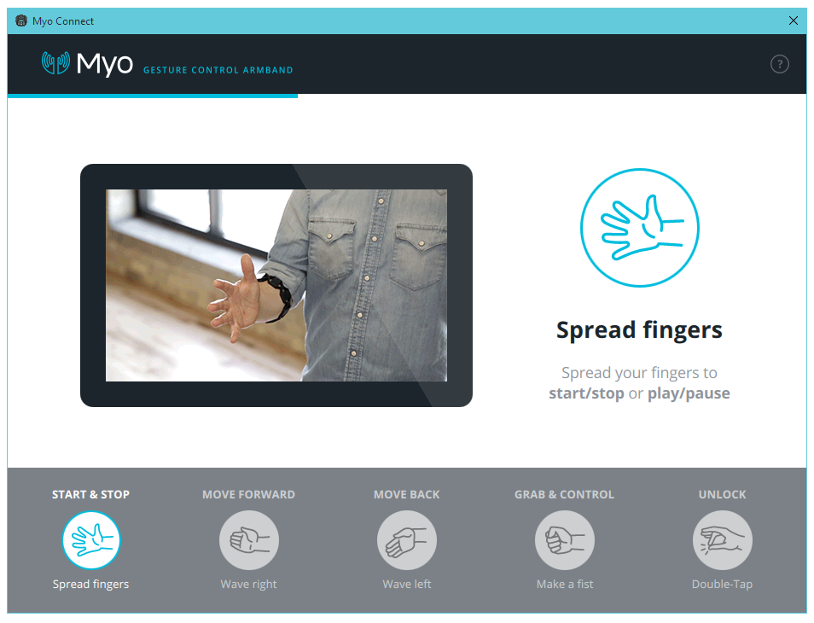

Slide 26
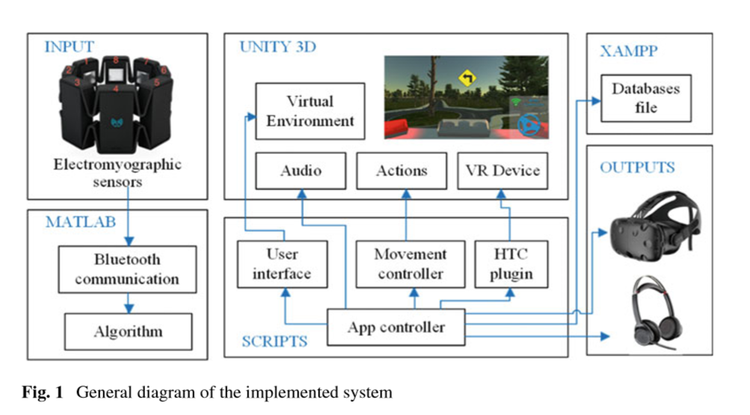

Slide 27
Methods
3. VR application
(1) The aim of this application is to drive a vehicle and completing a trajectory that is previously deﬁned by itself.
(2) When ﬁrst gesture is made, the vehicle is turned on.
(3) Moving the palm of the hand outward produces a turn to the right.
(3) Moving the palm of the hand inward produces a turn to the left.
(4) The rotation depends on the intensity of the gesture.
(5) When you open your hand, it indicates that you have reached the desired point and so the vehicle must stop.

Slide 28
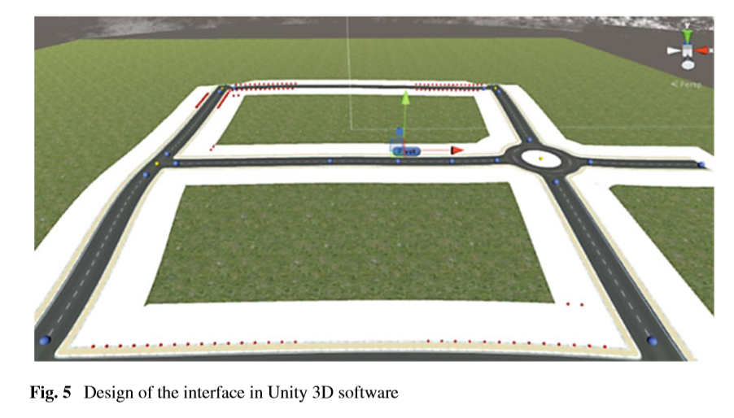

Slide 29
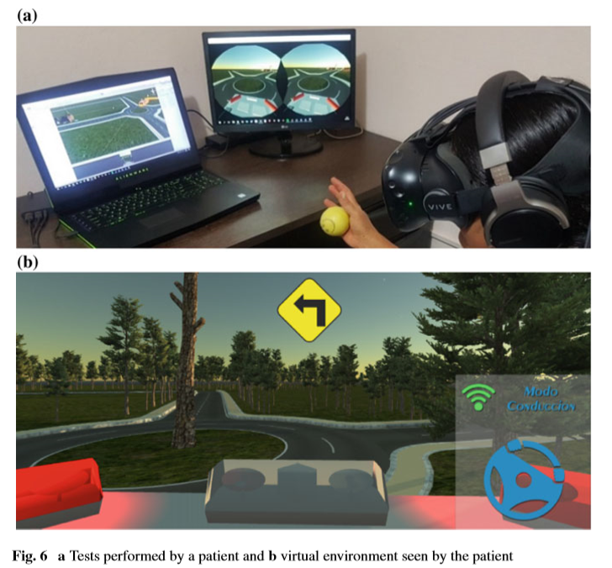

Slide 30
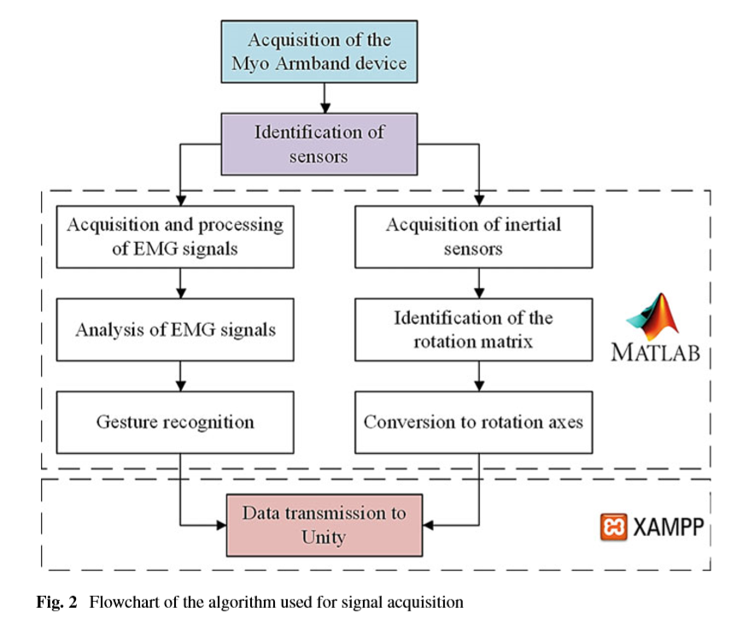
Methods
4. Flowchart

Slide 31
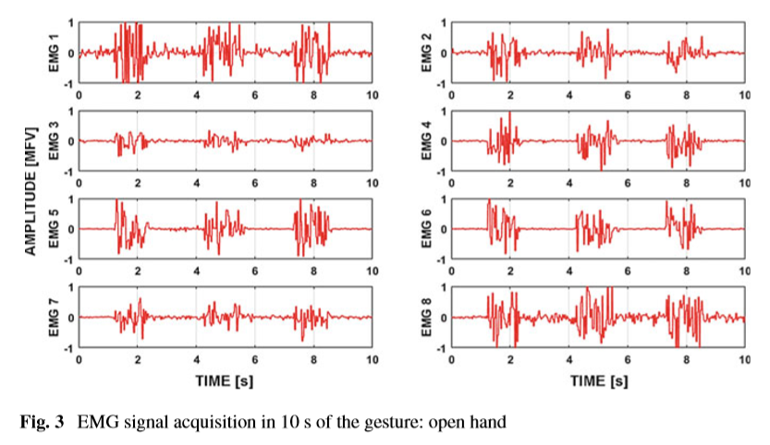

Slide 32
Methods
5. Test
(1) Patients performed the entrusted exercises in 30 min’ sessions, 2 times a week.
(2) This treatment lasted 4 weeks and was carried out by 5 retired soldiers, with an age range between 48 and 63 years.
(3) To determine the level of acceptance of this proposal, the usability test（易用性测试） SEQ has 14 questions.
(a) The ﬁrst seven questions(Q1–Q7)are related to the level of acceptance and immersion.
(b) The following four questions (Q8–Q11) are related to the effects and discomfort.
(c) The next two questions are related to the difﬁculty encountered when performing the tests.
(d) The last question is open, so the user can indicate if there is any discomfort when using the virtual system and its reasons.

Slide 33
Results
1. The results of the SEQ test performed by ﬁve users after using the virtual system are:(58,8.±0,27), The score obtained is greater than 40, It is determined that patients feel fully comfortable with the application.

Slide 34
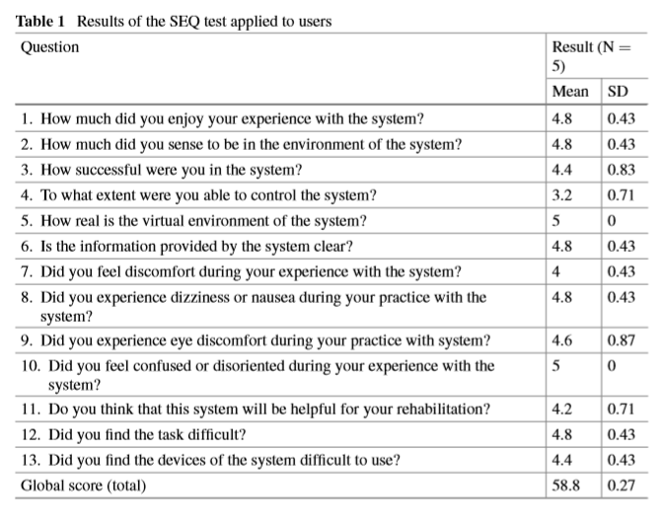

Slide 35
Conclusion
1. The application of the usability test SEQ shows that the interface presented to the user is easy to use, and does not cause discomfort.
2. It should be pointed out that this research has been evaluated from the point of view of the acceptance generated by this system, but not with a medical approach, given that the results are not conclusive when requiring a longer evaluation period.

